Slide 1
LAN Technologies

Slide 2
What is a LAN?
Local area means:
Private ownership
  freedom from regulatory constraints of WANs
Short distance (~1km) between computers
  low cost
  very high-speed, relatively error-free communication
  complex error control unnecessary
Machines are constantly moved
  Keeping track of location of computers a chore
  Simply give each machine a unique address
  Broadcast all messages to all machines in the LAN
Need a medium access control protocol
13.<number>

Slide 3
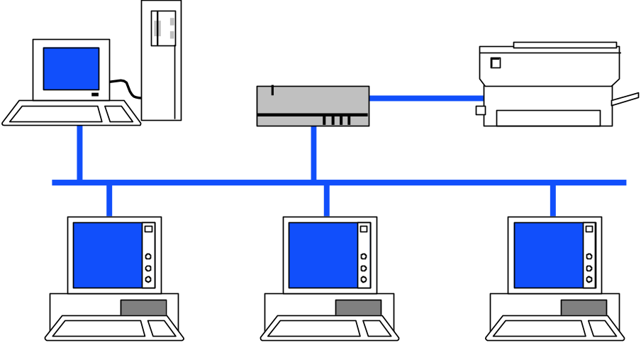
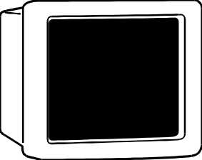
Typical LAN Structure
Transmission Medium
Network Interface Card (NIC)
Unique MAC “physical” address
RAM
Ethernet Processor
ROM
RAM
13.<number>

Slide 4
13-1 IEEE STANDARDS
In 1985, the Computer Society of the IEEE started a project, called Project 802, to set standards to enable intercommunication among equipment from a variety of manufacturers. Project 802 is a way of specifying functions of the physical layer and the data link layer of major LAN protocols.
Topics discussed in this section:
Data Link Layer
Physical Layer
13.<number>

Slide 5

Figure 13.1 IEEE standard for LANs
13.<number>

Slide 6
13-2 STANDARD ETHERNET
The original Ethernet was created in 1976 at Xerox’s Palo Alto Research Center (PARC). Since then, it has gone through four generations. We briefly discuss the Standard (or traditional) Ethernet in this section.
Topics discussed in this section:
MAC Sublayer
Physical Layer
13.<number>

Slide 7

Ethernet Evolution

Slide 8


IEEE 802.3 MAC Frame

Slide 9

Note
Frame length:
Minimum: 64 bytes (512 bits)
Maximum: 1518 bytes (12,144 bits)
13.<number>

Slide 10

Figure 13.6 Example of an Ethernet address in hexadecimal notation
13.<number>

Slide 11

Figure 13.7 Unicast and multicast addresses
13.<number>

Slide 12
Note
The least significant bit of the first byte
defines the type of address.
If the bit is 0, the address is unicast;
otherwise, it is multicast.
13.<number>

Slide 13
Note
The broadcast destination address is a special case of the multicast address in which all bits are 1s.
13.<number>

Slide 14

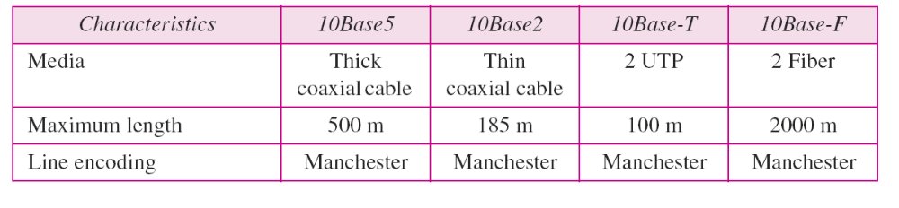
Categories of Standard Ethernet
( 10Mbps Specification )

Slide 15

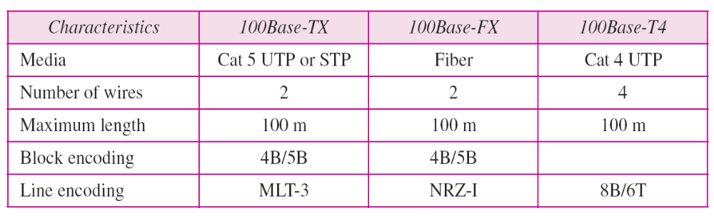
FAST ETHERNET

Slide 16


Gigabit Ethernet

Slide 17
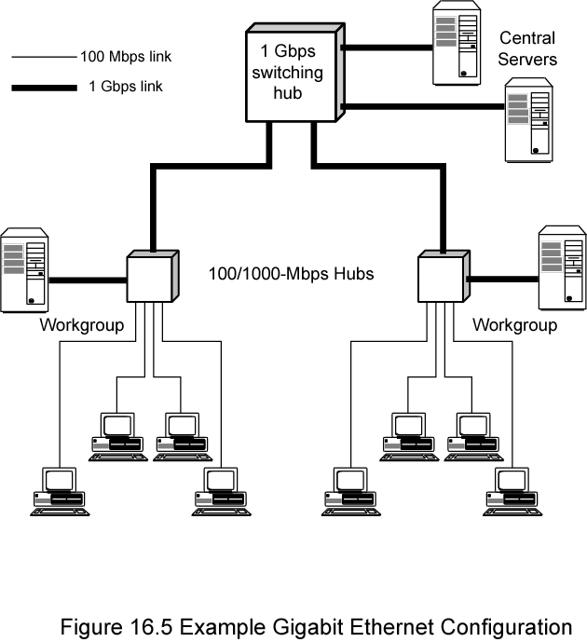
Gigabit Ethernet Configuration

Slide 18
Token Ring Operation
Token Ring and IEEE 802.5 are two principal examples of token-passing. Token-passing networks move a small frame, called a token, around the network.
Possession of the token grants the right to transmit. If a node receiving the token has no information to send, it passes the token to the next end station. Each station can hold the token for a maximum period of time
If a station possessing the token does have information to transmit, it seizes the token, alters 1 bit of the token (which turns the token into a start-of-frame sequence), appends the information that it wants to transmit, and sends this information to the next station on the ring.
While the information frame is circling the ring, no token is on the network (unless the ring supports early token release), which means that other stations wanting to transmit must wait.
Therefore, collisions cannot occur in Token Ring networks. If early token release is supported, a new token can be released when frame transmission is complete

Slide 19
Priority System
Token Ring networks use a sophisticated priority system that permits certain user-designated, high-priority stations to use the network more frequently. Token Ring frames have two fields that control priority: the priority field and the reservation field.
Only stations with a priority equal to or higher than the priority value contained in a token can seize that token. After the token is seized and changed to an information frame, only stations with a priority value higher than that of the transmitting station can reserve the token for the next pass around the network.
When the next token is generated, it includes the higher priority of the reserving station. Stations that raise a token's priority level must reinstate the previous priority after their transmission is complete.

Slide 20
Frame Format
Token Ring and IEEE 802.5 support two basic frame types:
    1.Tokens 2. Data/Command frames.
Tokens are 3 bytes in length and consist of a start delimiter, an access control byte, and an end delimiter.
Data frames carry information for upper-layer protocols
Command frames contain control information and have no data for upper-layer protocols.
Start Delimiter | Access Control | Frame Control | Dest Address | Src Address | Data | FCS | End Delimiter | Frame Status
1 | 1 | 1 | 6 | 6 | >=0 | 4 | 1 | 1
bytes
Data/Command
Start Delimiter | Access Control | End Delimiter
1 | 1 | 1
Token

Slide 21
Token Frame Fields
Start delimiter—Alerts each station of the arrival of a token (or data/command frame). This field includes signals that distinguish the byte from the rest of the frame by violating the encoding scheme used elsewhere in the frame.
Access-control byte—Contains the Priority field (the most significant 3 bits) and the Reservation field (the least significant 3 bits), as well as a token bit (used to differentiate a token from a data/command frame) and a monitor bit (used by the active monitor to determine whether a frame is circling the ring endlessly).
End delimiter—Signals the end of the token or data / command frame. This field also contains bits to indicate a damaged frame and identify the frame that is the last in a logical sequence.

Slide 22
Data/Command Frame Fields
Start delimiter—Alerts each station of the arrival of a token (or data/command frame). This field includes signals that distinguish the byte from the rest of the frame by violating the encoding scheme used elsewhere in the frame.
Access-control byte—Contains the Priority field (the most significant 3 bits) and the Reservation field (the least significant 3 bits), as well as a token bit (used to differentiate a token from a data/command frame) and a monitor bit (used by the active monitor to determine whether a frame is circling the ring endlessly).
Frame-control bytes—Indicates whether the frame contains data or control information. In control frames, this byte specifies the type of control information.

Slide 23
Data/Command Frame Fields
Destination and source addresses—Consists of two 6-byte address fields that identify the destination and source station addresses.
Data—Indicates that the length of field is limited by the ring token holding time, which defines the maximum time a station can hold the token.
Frame-check sequence (FCS)—Is filed by the source station with a calculated value dependent on the frame contents. The destination station recalculates the value to determine whether the frame was damaged in transit. If so, the frame is discarded.
End Delimiter—Signals the end of the token or data/command frame. The end delimiter also contains bits to indicate a damaged frame and identify the frame that is the last in a logical sequence.
Frame Status—Is a 1-byte field terminating a command/data frame. The Frame Status field includes the address-recognized indicator and frame-copied indicator.

